Slide 1
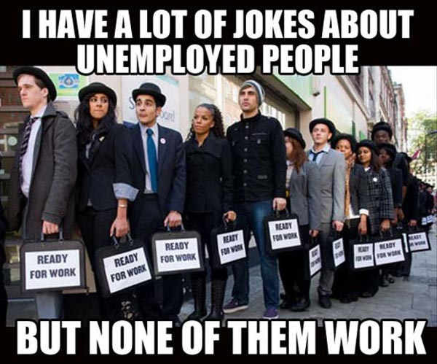
Chapter 7: Unemployment
Wayne Geerling
University of Texas

Slide 2
Big Questions
1. What are the major reasons for unemployment?
2. What can we learn from the employment data?

Slide 3

Measuring Unemployment
What would it be like if there was unemployment?
Is that desirable?
Misconception:

Slide 4
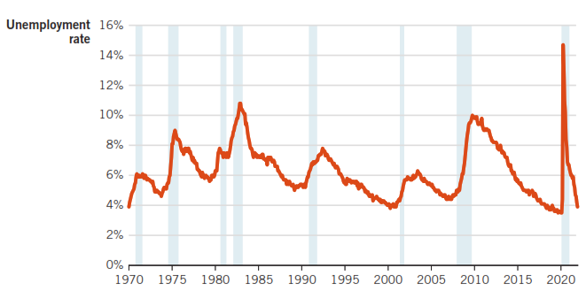
U.S. Unemployment Rate, 1970-2021
FRED: Current Unemployment Rate

Slide 5
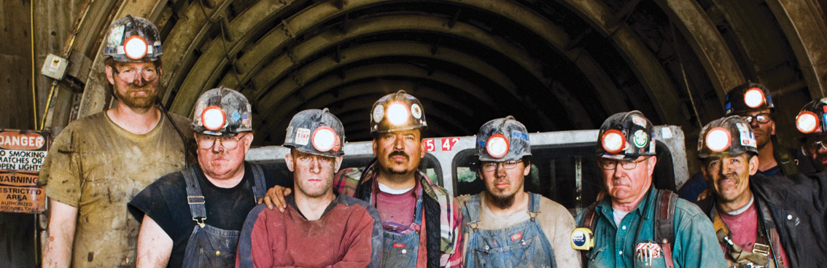
Unemployment
Types of Unemployment
Interpreting Unemployment
1. Structural
2. Frictional
3. Cyclical
Ways to look at unemployment
Shortcomings

Slide 6


Structural Unemployment
Unemployment caused by changes in the industrial make-up (structure) of the economy

Slide 7
Technological Progress
Is technological process good news for workers?

Slide 8
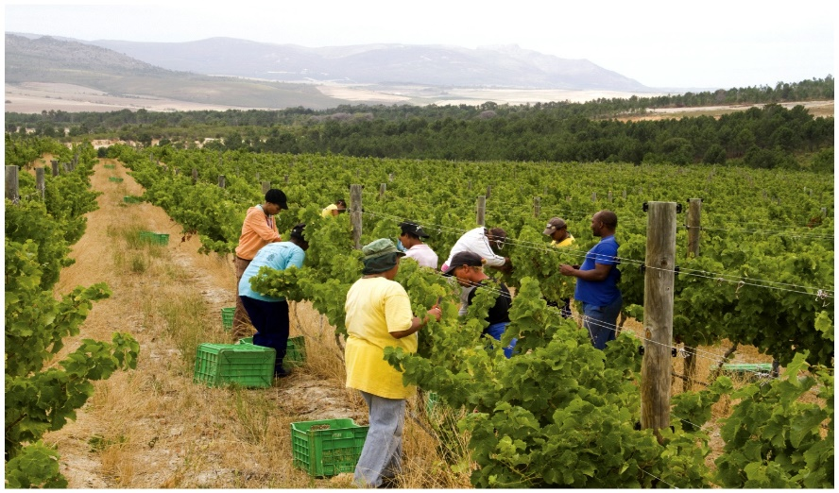

1. Structural Unemployment
Agricultural
Working in fields
Manufacturing
Working in factories
Service
Working in offices (online)
Changes in American economy over time

Slide 9
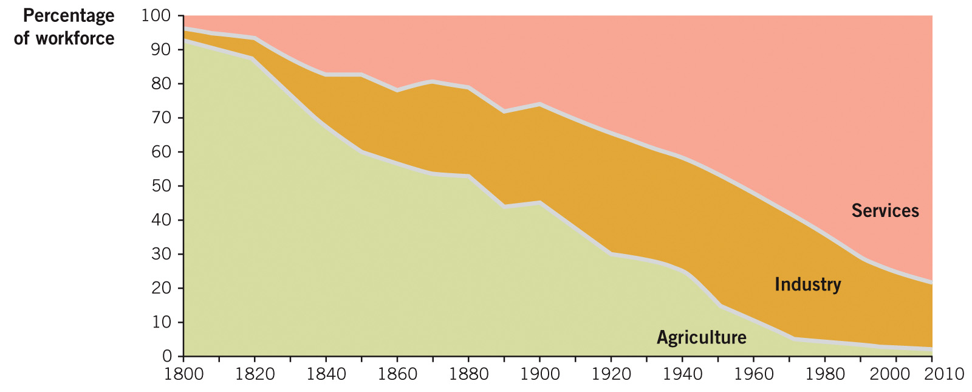
Growing and Changing Economies

Slide 10

Creative Destruction

Slide 11

2. Frictional Unemployment
Unemployment caused by time delays in matching available jobs and workers.
Less of an issue today than it was a generation ago.
Job websites make finding jobs (and finding good employees) easier than it has ever been.

Slide 12
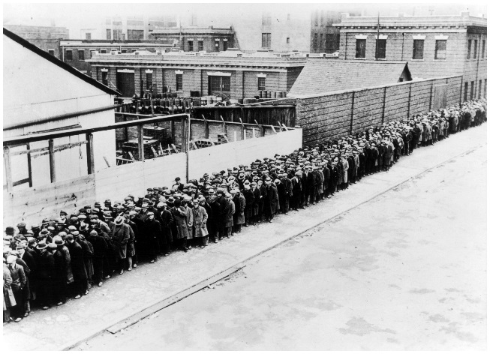
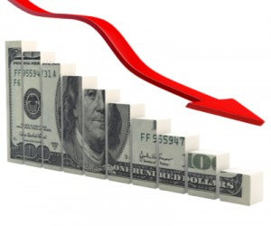
3. Cyclical Unemployment
Caused by economic downturns
Worst kind of unemployment
Skills are needed but there isn’t a job available

Slide 13
Are your skills needed?
NO
Yes
NO
Yes
NO
Yes

Slide 14
Natural Rate of Unemployment
Natural rate of unemployment: Typical unemployment rate that occurs when the economy is growing normally.
Unemployment during
healthy macroeconomic conditions (u*)
Unemployment during
recession
Cyclical
Natural Unemployment
Structural
Structural
Frictional
Frictional

Slide 15
The Natural Rate of Unemployment and Full-Employment Output
Full-employment output: Output by an economy with no cyclical unemployment
 | Healthy economy | Recession | Exceptional expansion
Unemployment (u) relative to u*
Economic output (Y) relative to Y*
Level of cyclical unemployment
u=u*
u>u*
u<u*
Y=Y*
Y<Y*
Y>Y*
Zero
Positive
Negative

Slide 16
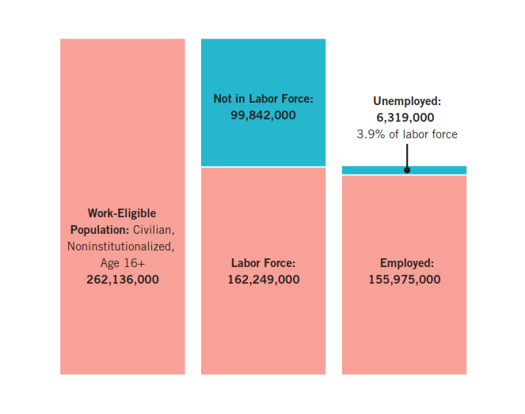
Population Breakdown (December 2021)

Slide 17
Measuring Unemployment
Unemployment rate (u)
The percent of the labor force that is unemployed
Labor force participation rate
People who are employed or actively seeking work
Unemployed
Labor force
Unemployment rate =
x 100
Labor Force
Work-Eligible Population
Labor Force
Participation Rate =
x 100

Slide 18

Example: “Longhorn Nation”
Working-age Population = 250,000
Employed = 160,000
Unemployed = 25,000
Calculate the unemployment rate & labor force participation rate (LFPR).
Labor Force = 160,000 + 25000 = 185000
Unemployment Rate = 25000/185000 x 100 = 13.5%
LFPR =185000/250000 x 100 = 75%

Slide 19
Unemployment is Like a Swimming Pool: Demonstration

Slide 20
Calculating the Unemployment Rate
Labor force: 100; 3 unemployed
Unemployment rate: 3% (3/100)
3 more workers become unemployed
Unemployment rate: 6% (6/100)

Slide 21

Calculating the Unemployment Rate
2 people find jobs
Unemployment rate: 2/98 (2.04%)
Drop out of the labor force

Slide 22

Calculating the Unemployment Rate
Unemployment rate: 4/100 (4%)
2 workers get tired, stop looking
Unemployment rate: 2/98 (2.04%)
Drop out of the labor force

Slide 23
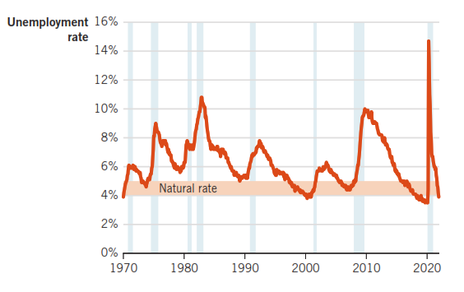
U.S. Unemployment Rate & Recessions, 1970-2021

Slide 24
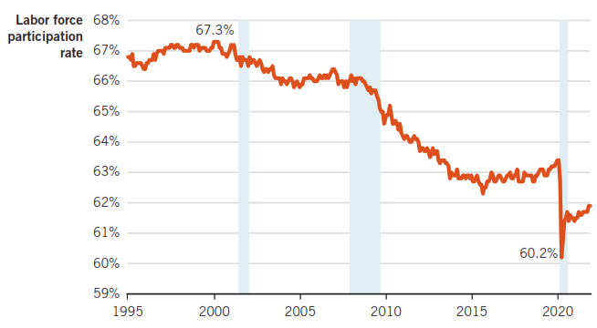
U.S. Labor Force Participation Rate, 1998-2021

Slide 25
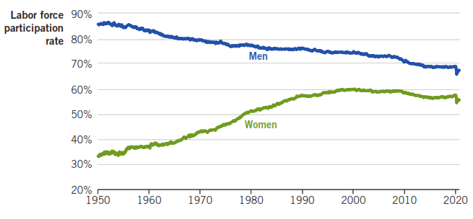
Trends in U.S. Labor Force Participation Rate, 1950-2020

Slide 26
Shortcomings of using the Unemployment Rate
1. It can be too narrow.
2. It does not reveal who is unemployed.

Slide 27
Shortcomings of using the Unemployment Rate
1. Discouraged workers: Those who are not working, have looked for a job in the past 12 months and are willing to work, but have not sought employment in the past four weeks.
The existence of discouraged workers will underestimate the “real” unemployment rate.
There are people who really do want to work, but we’re not counting them as or even as part of the

Slide 28
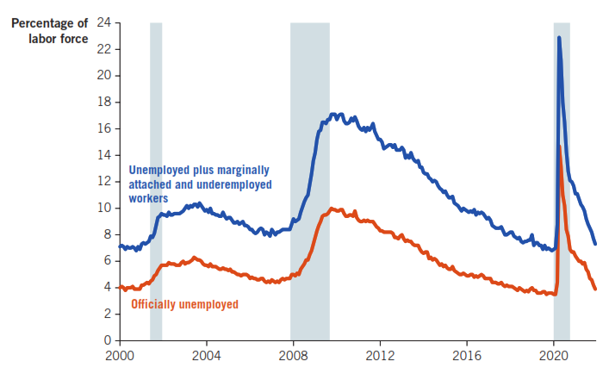
A Broader Measure of U.S. Labor Market Problems, 1998-2021
U3 (official) v U6 (unemployed + discouraged + underemployed workers)

Slide 29
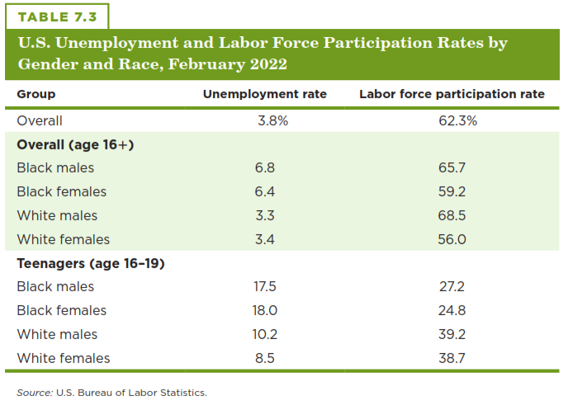
Labor Market Data: Race & Gender

Slide 30
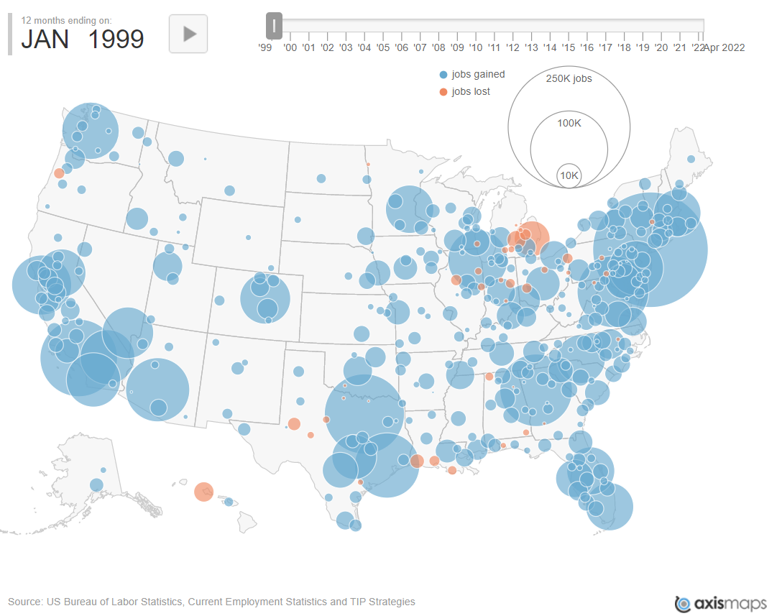
The Geography of Job Creation & Loss

Slide 31
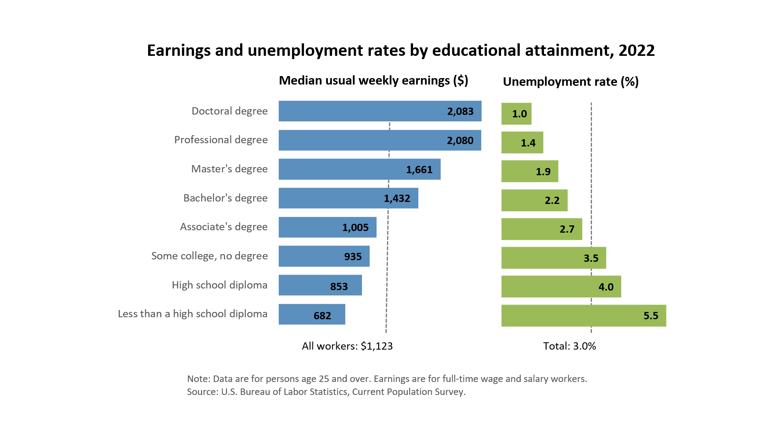
Some Practical Advice: Finish Your Degree!

